Slide 1
The Corporate Transparency Act: How it Impacts Community Associations
Adam M. Beaudoin
P: 910.794.4847
E: amb@wardandsmith.com
Matthew A. Jones
P: 910.794.4821
E: majones@wardandsmith.com
2024©Ward and Smith, P.A.

Slide 2
The Corporate Transparency Act
Enacted on 1/1/2021 as part of the National Defense Authorization Act of 2021 and under the scope of the Money Laundering Act of 2020.
Intended to provide law enforcement with beneficial ownership information for the purpose of detecting, preventing, and punishing terrorism, money laundering, and other misconduct through business entities.

Slide 3
The Corporate Transparency Act
Requires certain business entities ("Reporting Company") to file, in the absence of an exemption, information, and include information on the "Beneficial Owners" of the Reporting Company with the Federal Crimes Enforcement Network ("FinCEN") to U.S. Department of Treasury.

Slide 4
When Is It Effective?
January 1, 2024
Entity created or registered to do business before January 1, 2024, will have until January 1, 2025 to file its initial beneficial ownership information report.
Entity created or registered on or after January 1, 2024, will have 90 days to file its initial beneficial ownership information report. Runs from date of formation or registration. Starting January 1, 2025, reduces to 30 days for new formations.

Slide 5
What Entities Are Required To Report and Provide Beneficial Ownership Information?
"Reporting Companies"
ARE . . . .
Domestic Reporting Company
Corporation
LLC, LLP, LLLP, Business Trusts, and LP.
Nonprofit Corporations
Any other entity created by the filing of a document with a Secretary of State or any similar office under law or Indian tribe.
General Partnerships and Statutory Trusts fall outside the scope of the Act

Slide 6
Reporting Companies (Cont.)
Foreign Reporting Company
Corporation, LLC, or other entity formed under the law of a foreign country, AND
Registered to do business in any U.S. state or in any Tribal jurisdiction.
Some foreign companies may simply own US real estate and do not have to register to do business or apply for a certificate of authenticity.

Slide 7
Exemptions From Filing And Beneficial Ownership Reporting
Generally industries which are already heavily regulated
Certain types of securities reporting issuers
Registered under Section 15 of Security Exchange Act of 1934
Or required to file supplementary, and periodic information under Section 15(d)
A U.S. government authority
Certain types of banks
Federal or state credit unions
Bank holding companies
Certain types of money transmitting services

Slide 8
Exemptions (cont.)
Broker/Dealer defined in Section 3 of the Security Exchange Act, registered under Section 15
Securities and Exchanges
Certain other types of entities registered at a Secretary of State
Certain types of investment companies
Certain types of venture capital advisors
Insurance companies defined in Section 2 of Investment Company Act of 1940.
State-licensed insurance producers with physical office in the state.

Slide 9
Exemptions (cont.)
Commodity Exchange Act registered entities
Any public accounting firm registered with Section 102 of the Sarbanes-Oxley Act of 2002
Certain types of regulated public utilities (telecom, electric, natural gas, or water/sewer within U.S.)
Financial market utility
Certain pooled investment vehicles
Certain types of tax-exempt entities
Entities assisting a tax-exempt entity.

Slide 10
Exemptions (cont.)
Large operating companies with at least 20 full-time employees, more than $5,000,000 in gross receipts or sales, and an operating presence at a physical office within the United States.
The subsidiaries of certain exempt entities
Not money transmitting businesses
Not pooled investment vehicles
Not entity assisting tax-exempt entities
Certain types of inactive entities that were in existence on or before January 1, 2020.

Slide 11
Tax-Exempt Entities
501(c) and exempt from tax under Section 501(a) of the Code.
Political organization exempt under Section 527(e)(1) of the Code.
A trust described in paragraph (1) or (2) of Section 4947(a) of the Code.
HOAs filing under IRS Revenue Code 528, are NOT 501(c) organizations.
HOA's will need to adopt policies to identify benefitted owners and collect the needed information to be reported
HOA's that qualify as 501(c)4 social welfare organizations or social clubs 501(c)7

Slide 12
Tax-Exempt Entities (cont.)
501(c)4 – HOA may qualify as a social welfare organization if it is operated for the benefit of all the residents of a community.
Roadways and amenities it owns and maintains must be open to the public and NOT just its own members. It must also show that is DOES NOT engage in exterior maintenance of private homes.
501(c)7 – Social clubs organized for pleasure, recreation, and other similar purposes.

Slide 13
Who Is A Beneficial Owner Of A Reporting Company?
An individual who directly or indirectly exercises "Substantial Control" over Reporting Company,
OR
An individual who directly or indirectly owns or controls 25% or more of "Ownership Interests" of Reporting Company.

Slide 14
What Is Substantial Control?
Direct, determine, or exercise substantial influence over, important decisions the Reporting Company makes.
Any Senior Officer is deemed to have substantial control over Reporting Company.
President
CFO
General Counsel
CEO
COO
Directors
Managers
Decision maker
Or any officer who performs a similar function regardless of title.

Slide 15
What Are Considered "Ownership Interests"?
Shares of stock
LLC ownership interests
Trustee of Trust exercising control over Reporting Company
Debt instruments
It is possible to have substantial control without an "ownership interest," like in an HOA.

Slide 16
HOA
Each Director and Officer – decision maker or person who has substantial influence over important matters
Committee Members?
Management company could be considered a beneficial owner if the terms of the management contract give manager substantial influence
*Independent decision making is the test.

Slide 17
What Information Must Be Reported?
Companies created or registered on or after January 1, 2024:
Itself
Beneficial Owners, and
Company Applicants
Can be up to two individuals
Individual who directly files the document that creates entity
Individual that is primarily responsible for directing or controlling the filing
Management Company?

Slide 18
What Information Must Be Reported?
Companies registered before January 1, 2024:
Itself
Beneficial Owners

Slide 19
What Must Be Reported About Itself?
Legal name
Trade names, "doing business as"
Current street address of its principal place of business if address is in United States
Outside the U.S., current address from which the country conducts business in the U.S.
Jurisdiction of formation or registration
Taxpayer ID number

Slide 20
What Must Be Reported About Beneficial Owners And Company Applicants?
Individuals name, DOB, and address.
Residential street address (attorney business address)
A unique identifying number from an acceptable identification document*
Driver's license or ID card issued by state
Passport
Non-expired passport by a foreign government
The name of the state or jurisdiction that issued the identification document
*Image of the identification document

Slide 21
How Will The Information Be Reported?
Electronically to FinCEN website
*30-days to report changes to beneficial ownership or corrections in information upon discovery
*No Fee

Slide 22
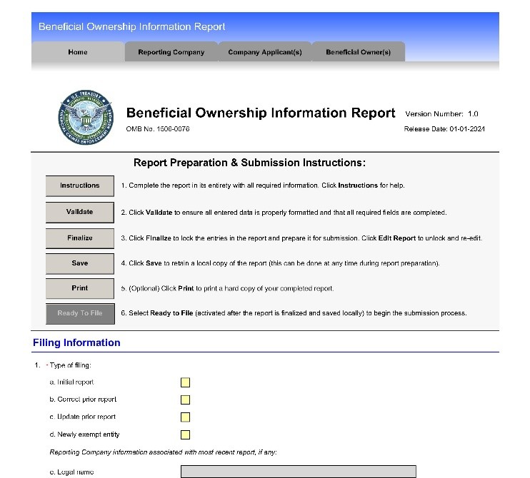
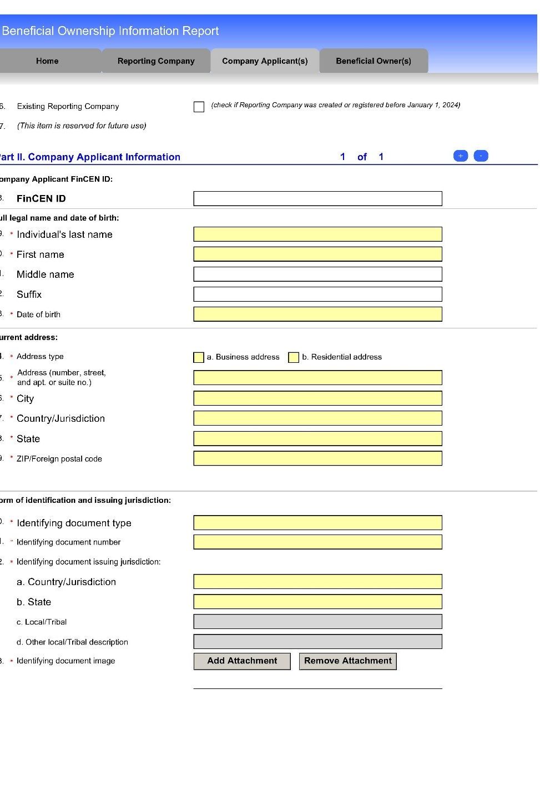
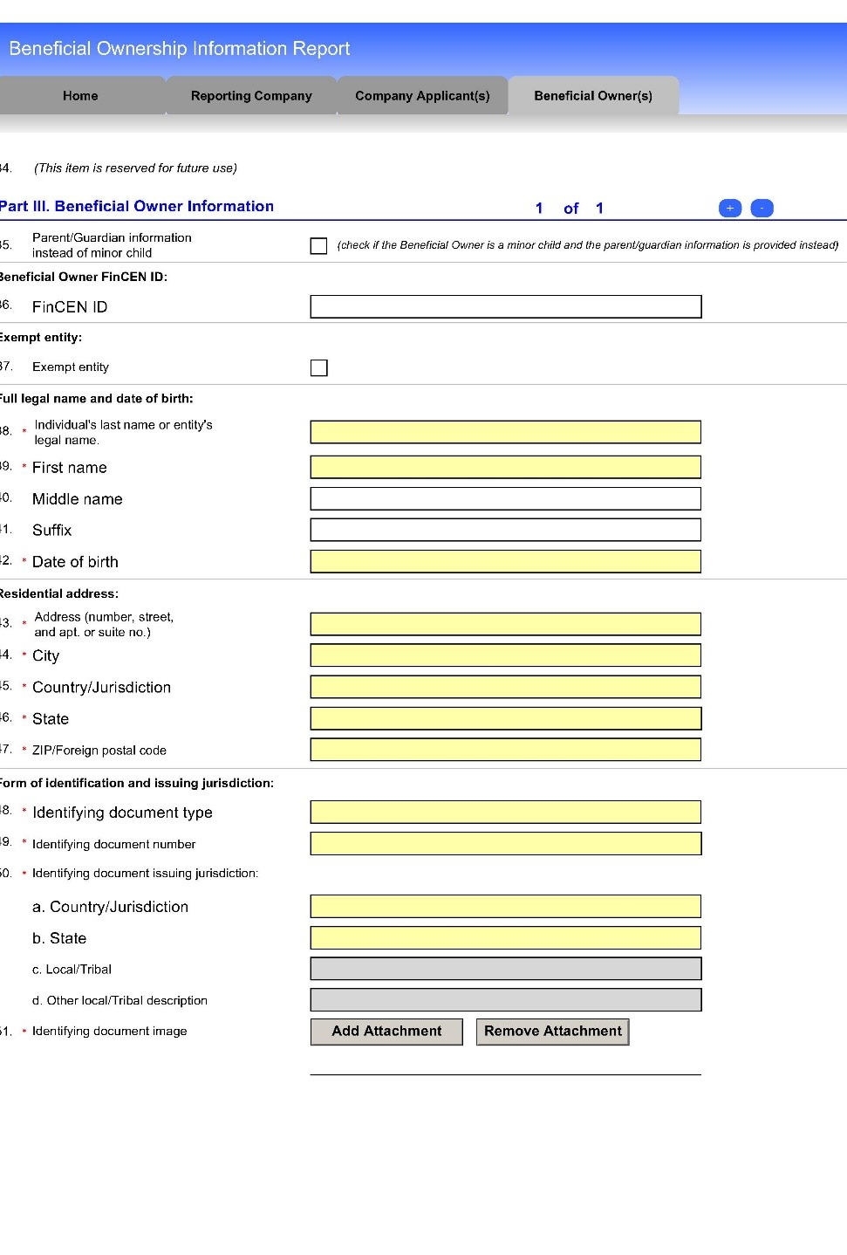
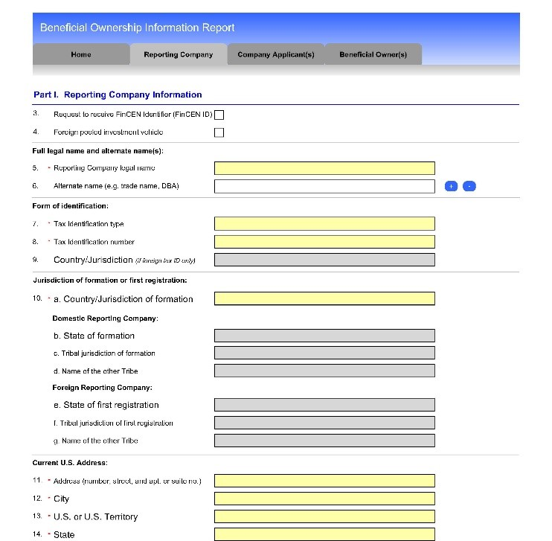
www.fincen.gov/boi

Slide 23
Information Will NOT Be Publicly Available.
U.S. Federal Law Enforcement Agencies
With court approval, to certain other enforcement agencies.
To non-U.S. law enforcement agencies
With consent of the Reporting Company, to financial institutions and their regulators.

Slide 24
Civil and Criminal Penalties
Willful Reporting Violations
Civil – $500 per day that the violation continues
Criminal – fine up to $10K, and/or 2 years imprisonment
Unauthorized Disclosure or Use
Civil – $500 per day that violation continues
Criminal – fine up to $250K and/or 5 years imprisonment
Part of a pattern of any illegal activities involving more than $100,000.00 in a 12-month period, a fine of not more than $500,000.00 and/or 10 years imprisonment

Slide 25
Statutory Safe Harbor
No civil or criminal penalties if inaccurate report is voluntarily corrected with 90 days from date filing should have been made.
Reasonable Cause
Negligent violations not penalized.
Violations for reasonable cause and NOT willful neglect, not penalized.

Slide 26
QUESTIONS

