Slide 1
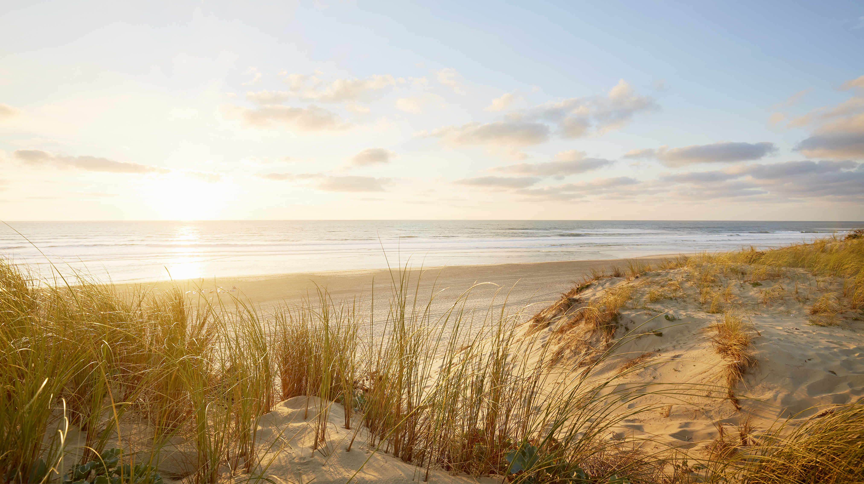
Achieving Smart Growth in Brunswick County
Alliance of Brunswick County Property Owners Associations (ABCPOA)
September 2024

Slide 2
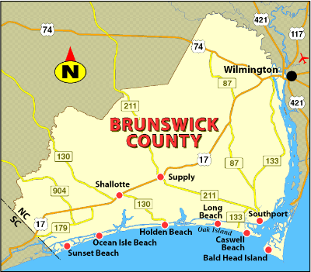
Agenda
Some Context
Implementing the Plan
Obstacles to Smart Growth
Actions You Can take

Slide 3
Some Context
Smart growth:
Facilitates logical and thoughtful expansion of housing and infrastructure
Supports natural areas and other things unique to area.
Development in BC is unchecked, not “smart”
Result: haphazard growth
Infrastructure inadequate.
Clear cutting increases flood risk, takes away natural tree canopy.
Over 34,000 housing units approved since 2021; infrastructure falling further behind.

Slide 4
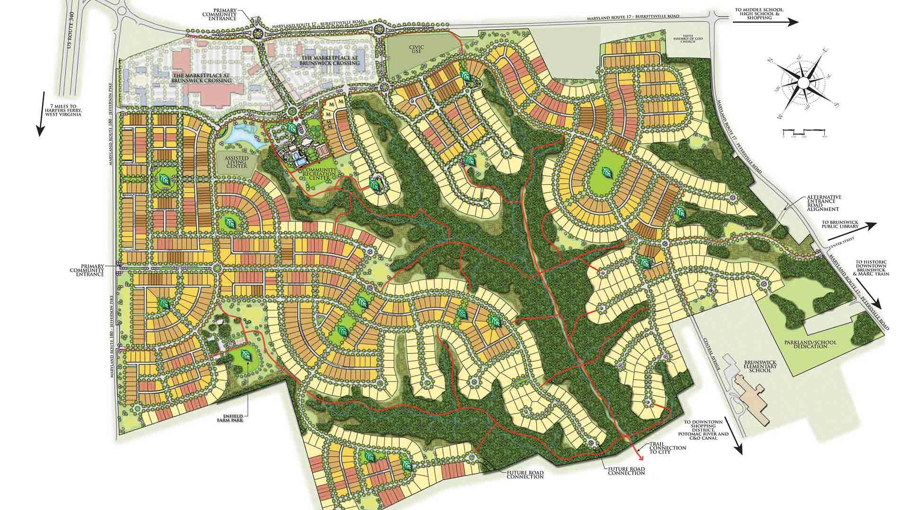
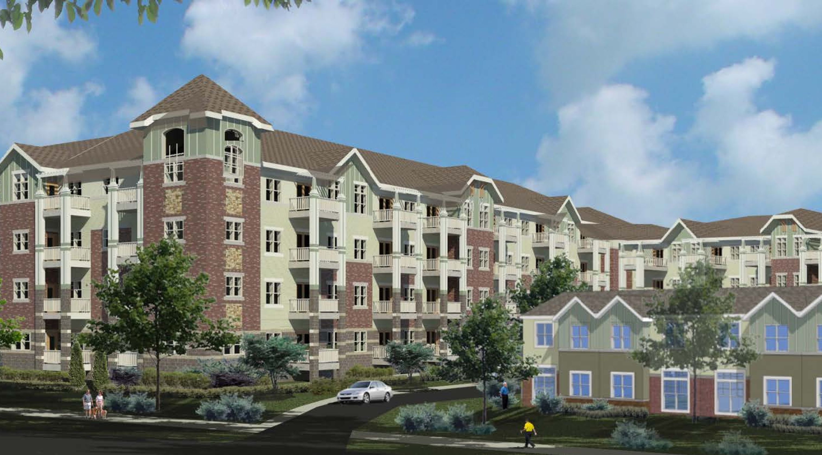
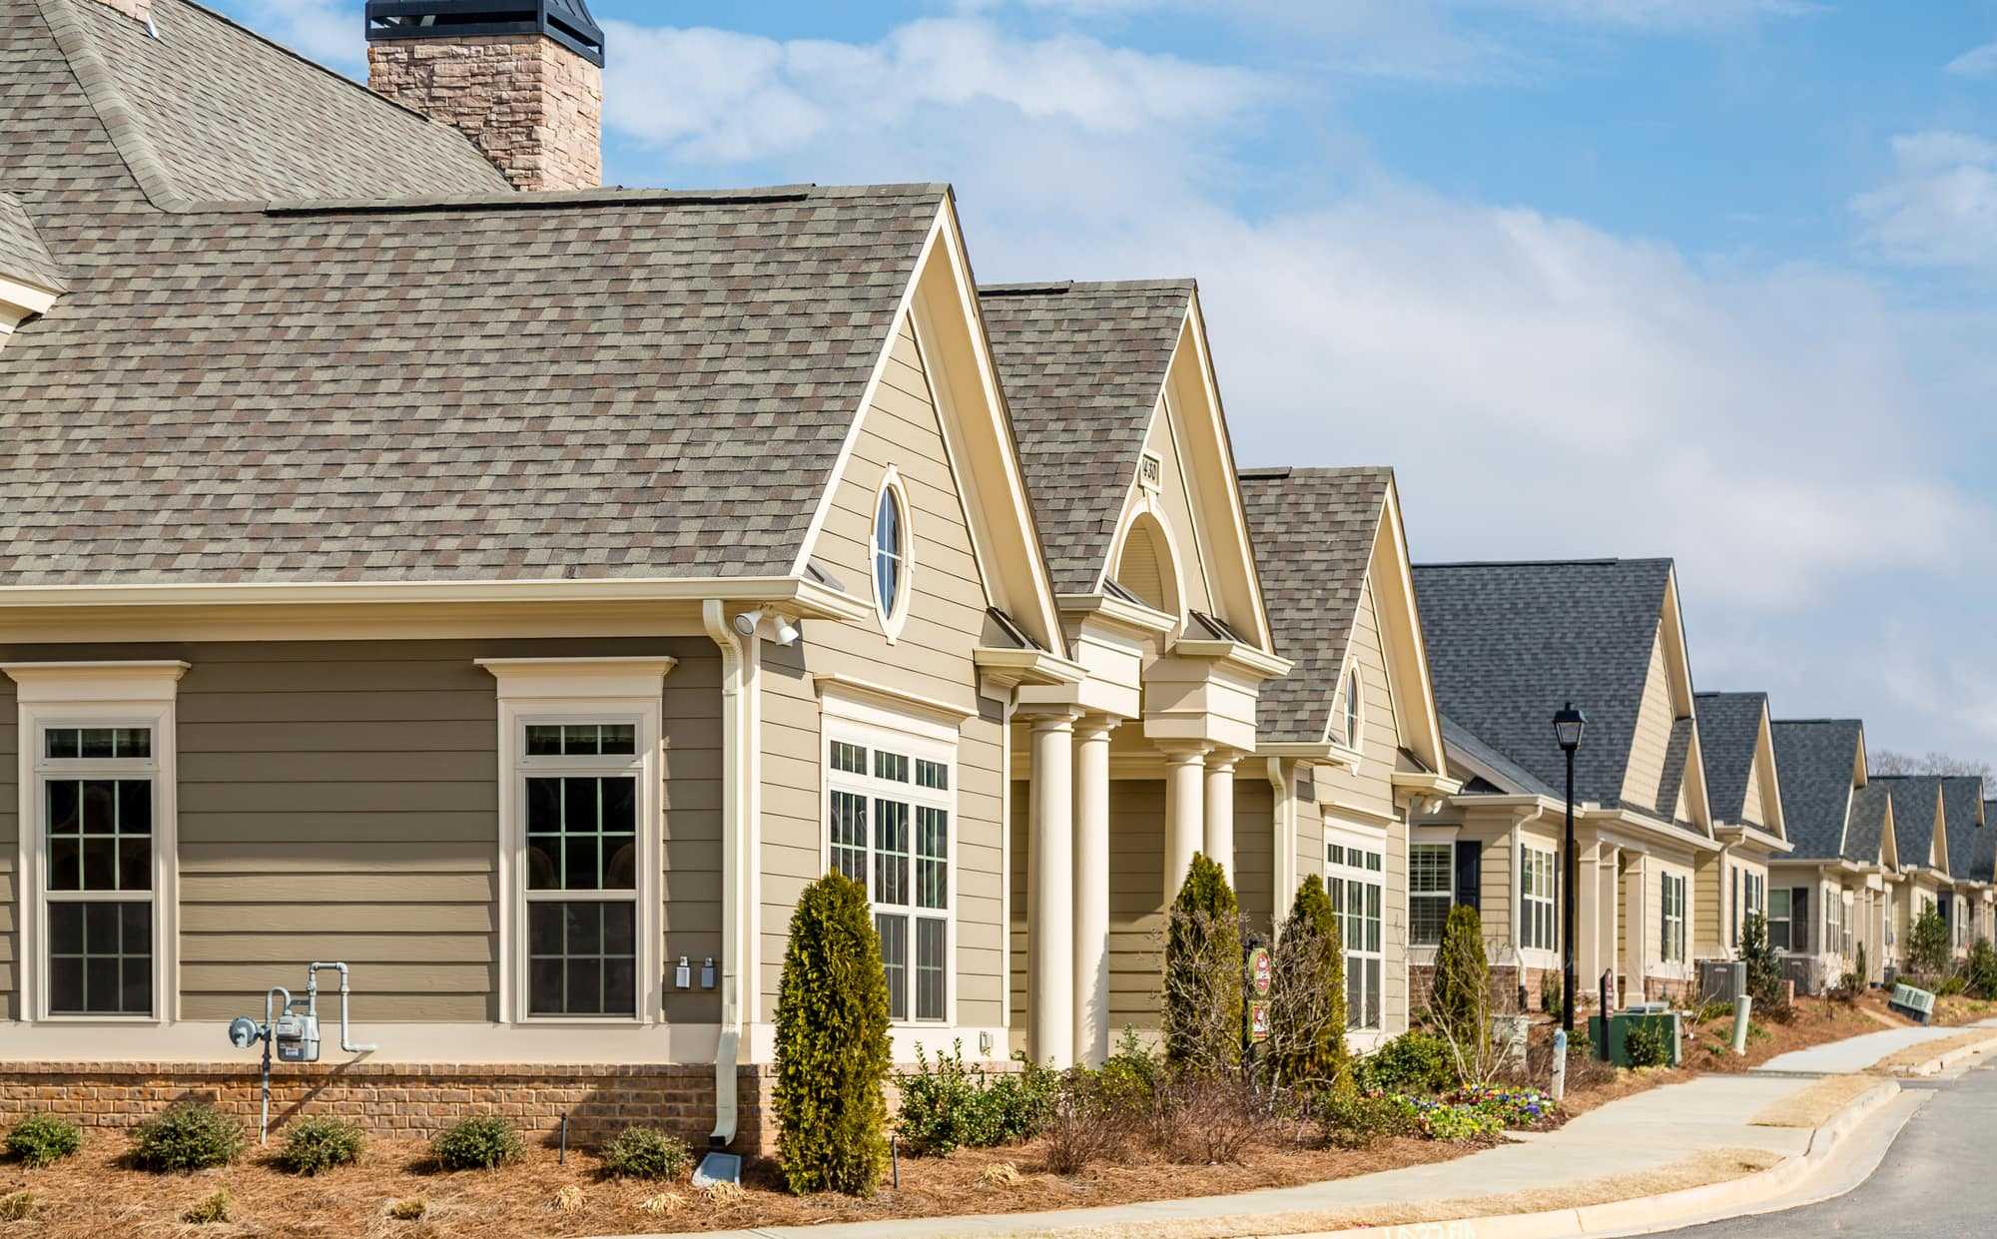
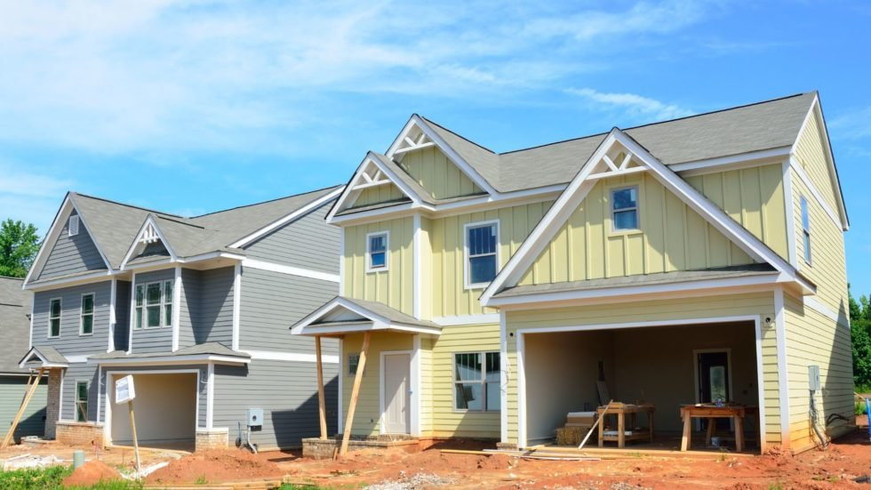

Slide 5
Some Context: Blueprint Brunswick
Coastal Area Management Act (CAMA)¹ requires all coastal regions of NC to develop, approve, & certify a land use plan
Blueprint Brunswick is most recent Land Use Plan
Completed in 2022
Adopted by BOC in 2023
Outlines a vision for smart growth in BC
Developers’ community has shown limited support of vision
ABCPOA firmly supports Blueprint Brunswick vision
ABCPOA formed UDO Sub-committee (2023) to engage w/ Planning Dept.
1. NC Statute 15A NCAC 07B

Slide 6
Implementing the Plan The Unified Development Ordinance: UDO
UDO is the legal document outlining zoning and development standards.
Development must meet these minimum standards for approval
BOC approved existing UDO in 2007
BOC approved multiple amendments since then many of which encouraged development
Pros:
More flexibility for staff to alter plans and meet desire for conservation based design, greater stormwater requirements, other factors to improve developments
Cons:
Amendments loosened/removed zoning protections
Allowed developers to change zoning within their proposed development
Enabled increased density, decreased setbacks, and clustering of residential units within planned developments

Slide 7
Implementing the Plan: Blueprint Brunswick & UDO
Blueprint Brunswick (approved, certified vision)
UDO Standards
(supports vision in Blueprint Brunswick)
SMART GROWTH
for
Brunswick
County

Slide 8
Achieving The Vision Why Is It Taking So Long?
Blueprint Brunswick begun in 2020, completed end of 2022
BOC approved in February 2023
Inconsistencies exist between current (2007) UDO and Blueprint Brunswick
Inconsistencies noted in 2022 plan
UDO must be revised to implement the vision of Blueprint Brunswick

Slide 9
Why Is It Taking So Long? Board of Commissioners
Failed to embrace implementation of Blueprint Brunswick
Not responding to concerns voiced by the community
Resisting efforts by Planning Dept. to align UDO guidelines with Blueprint Brunswick
Transportation Impact Analysis (TIA) Text Amendment
Transportation Overlay Zoning (TOZ) Text Amendment & Map
Tree & Greenspace Text Amendments
Current Board of Commissioners is biggest obstacle to achieving vision of smart growth

Slide 10
What Can Be Done?
Initiatives of ABCPOA since 2023
Contact Planning Dept
Speak at hearings
Write Commissioners
Write Planning Board members
Letters to the Editor/speak to Press
Meet with BOC and/or PB members
Evaluate candidates prior to voting
☑︎
☑︎
☑︎
☑︎
☑︎
☑︎
Today

Slide 11
Evaluating Commissioner Candidates The Incumbents
All commissioners:
Were involved in UDO changes enabling unchecked growth
Were involved in creation and approval of Blueprint Brunswick
Denied recent key amendments supporting resident concerns (e.g., trees, traffic)
Pat Sykes
Pursuing her 4th term
16 YEARS
Mike Forte
Pursuing 3rd term
12 YEARS
Frank Williams
Pursuing 4th term
16 YEARS

Slide 12
Who Do Incumbents Really Represent? Largest Campaign Contributors
Pat Sykes: $53,560
Frank Williams: $109,371
Mike Forte: $59,464
$4K Cape Fear Engineering
$3K Developer Of Compass Pointe And Ashton Farms
$5.1 Medaci Wellness
$5K Dewitt Carolina
$3K Whiteville Rentals
$10k Cape Fear Engineering
$3K Developer Of Compass Pointe And Ashton Farms
$2.5K Logan Homes VP
$2 Owner Greenfield Communities
$2K Nai Tri Properties
$10K Cape Fear Engineering
$6.4K Logan Homes
$4.5K Andrew Sandman
$4.5K Hardee and Son
$5K Osha Ridge Plantation
$5K Coterra Company realtor
Source: Aug 8, Port City Daily

Slide 13
The Challengers Underfunded and No Donations from Developers
Robert Fulton: $6,009
Lloyd Simmons: $3,316
Jonathan Damico: $2,535
$4,599 Individual Donations
$816 Political Party Committee
$2,500 Individual Donations
$816 Political Party Committee
$2,035 Individual Donations
$500 Political Party Committee
Source: BC Board of Elections, 2nd quarter filing

Slide 14
Next Steps
Know the Plans
Blueprint Brunswick https://www.brunswickcountync.gov/176/Plan-Documents
UDO https://www.brunswickcountync.gov/DocumentCenter/View/5460
Choose candidates wisely based on history and positions most important to you
Continue to hold BOC accountable
Speak at meetings
Submit letters to BOC, newspapers
Meet directly with commissioners
VOTE - This election will make the difference between the status quo and a change in our approach to development
May not get another chance for 4 years

